Slide 1
Static Web Apps
Lecturer: Ngo Huy Bien
Software Engineering Department
Faculty of Information Technology
VNUHCM - University of Science
Ho Chi Minh City, Vietnam
nhbien@fit.hcmus.edu.vn

Slide 2

Objectives
To create a static web app.

Slide 3

Contents

Slide 4

References

Slide 5
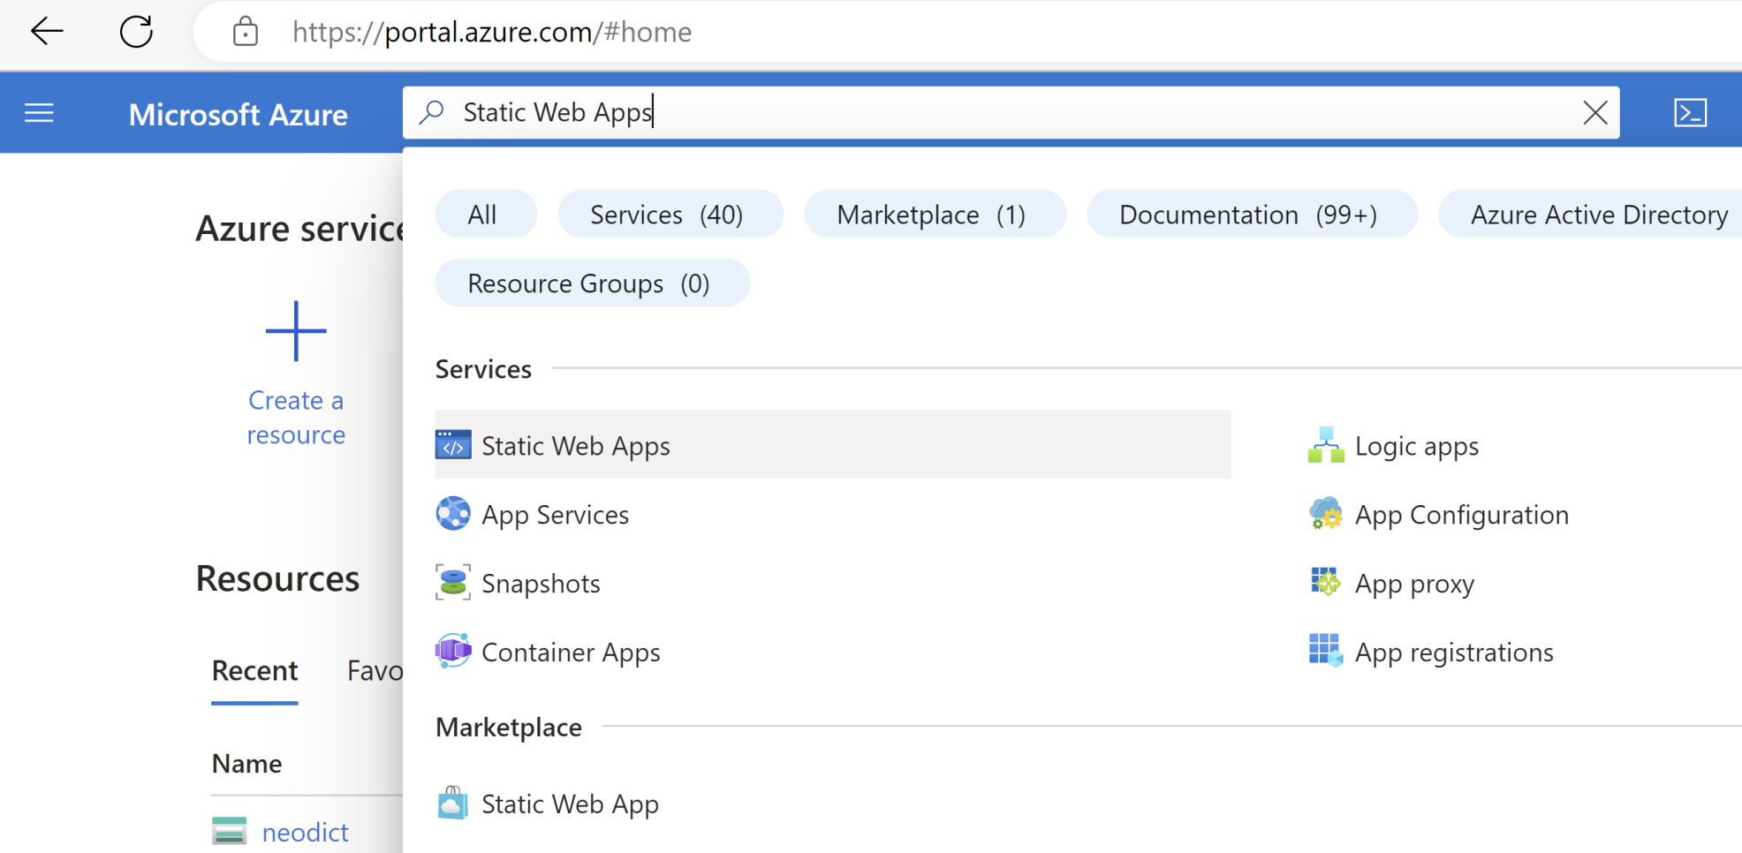
1. Open Static Web Apps Service

Slide 6
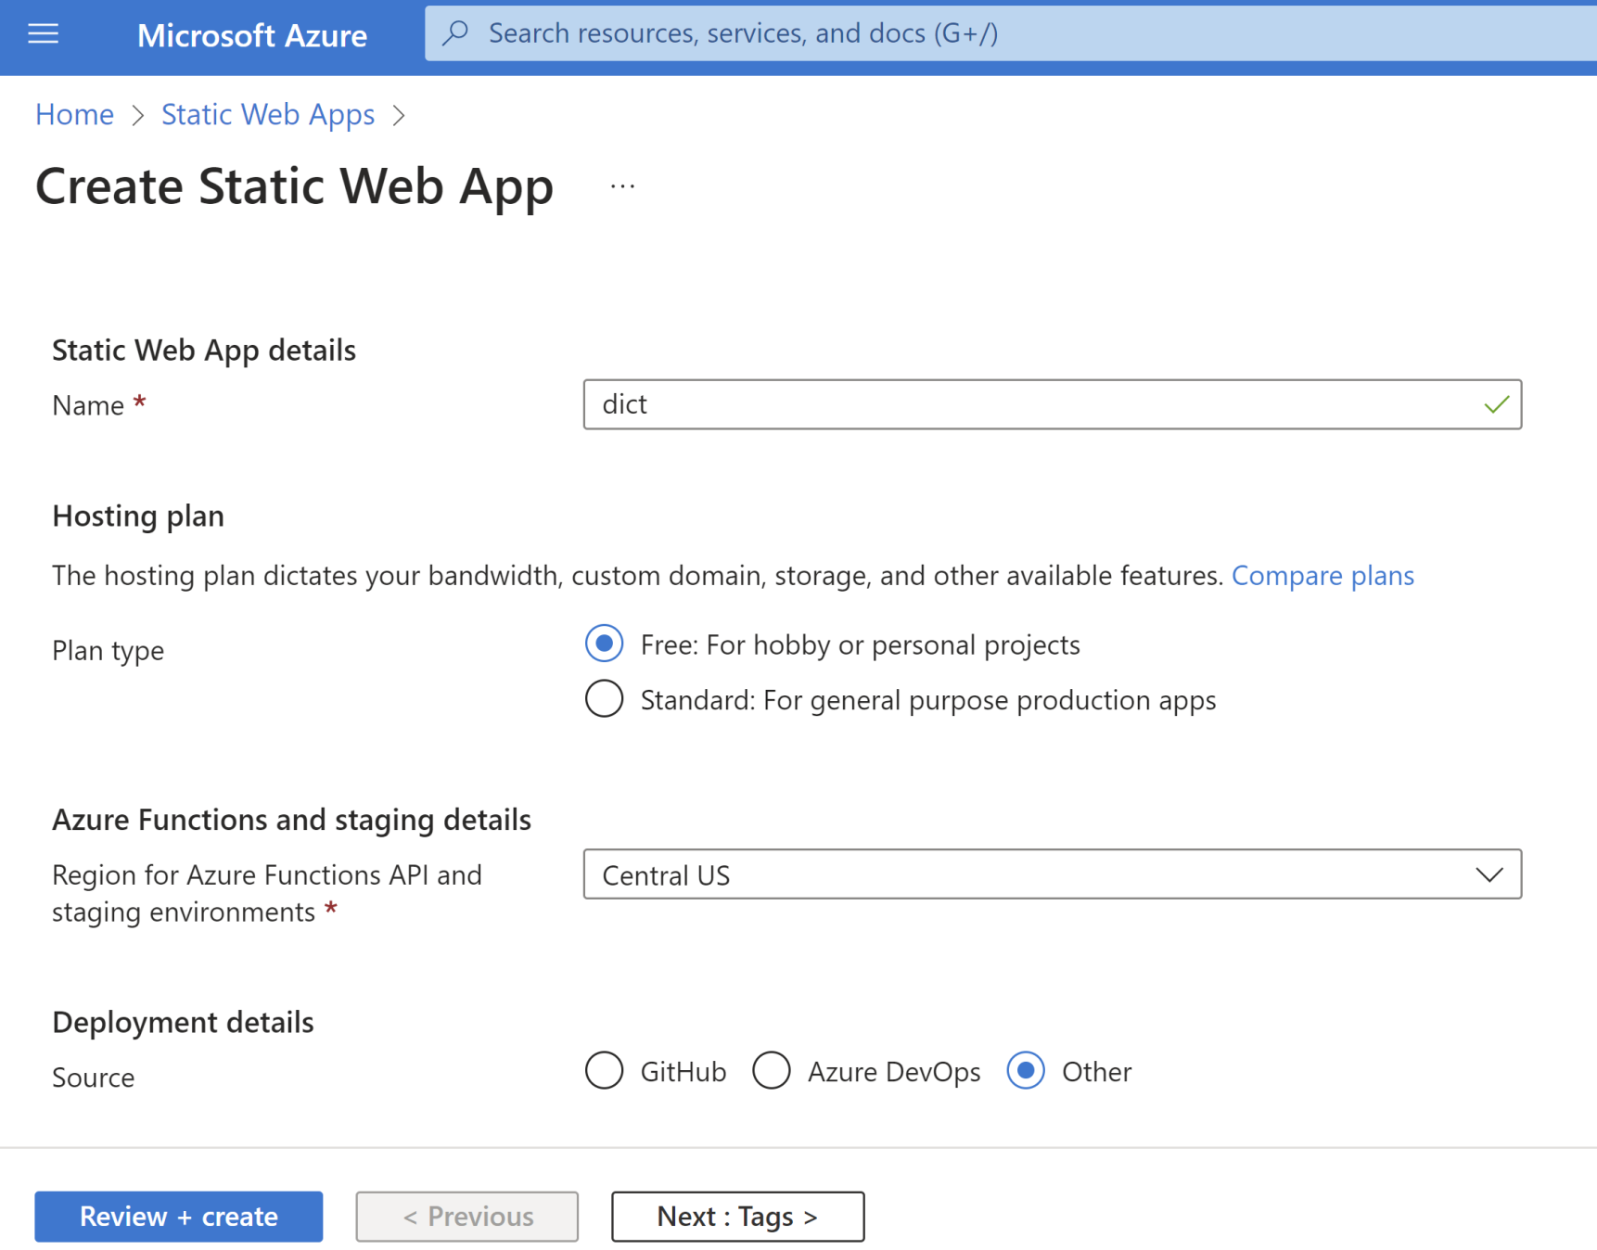
2. Enter a Name

Slide 7
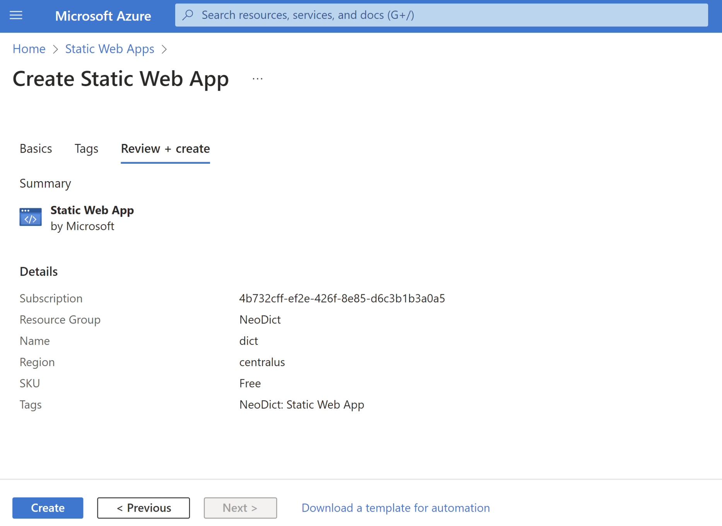
3. Confirm Static Web App Creation

Slide 8
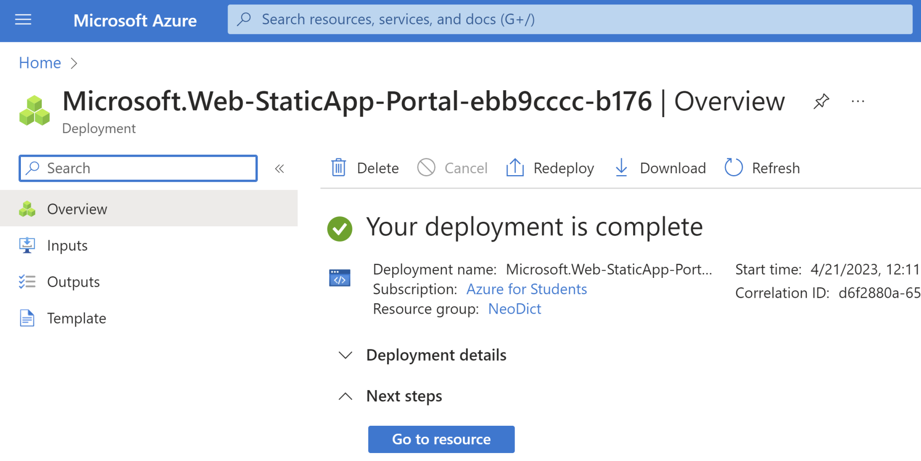
4. Go to Resources

Slide 9

Thank You & See You Again

